Slide 1
Data Analysis
Catalogue
Distributions
Risk Tolerance VS. GBP Asset Value
Composure VS. Total GBP Assets
Impact Desire VS. Total GBP Assets
Interaction Insights
Confidence VS. Total GBP Assets
Impulsivity VS. Total GBP Assets

Slide 2
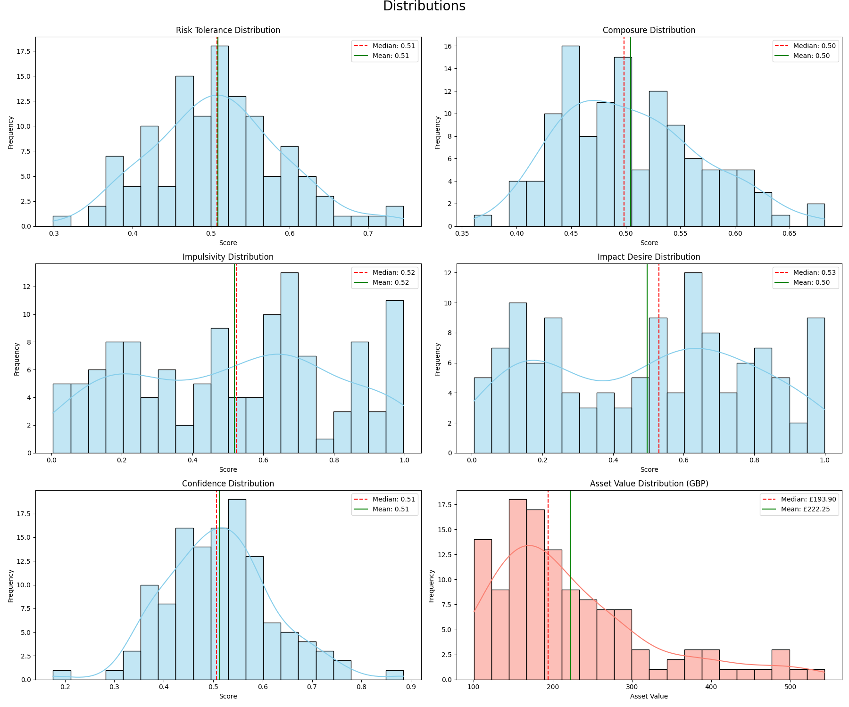
1. Distributions in general
Most personality traits show approximately normal distributions
Composure is slightly left-skewed
Impact desire shows a bimodal distribution
Asset values are right-skewed, indicating most investors have moderate assets while a few have very high assets (standard deviation is large)

Slide 3
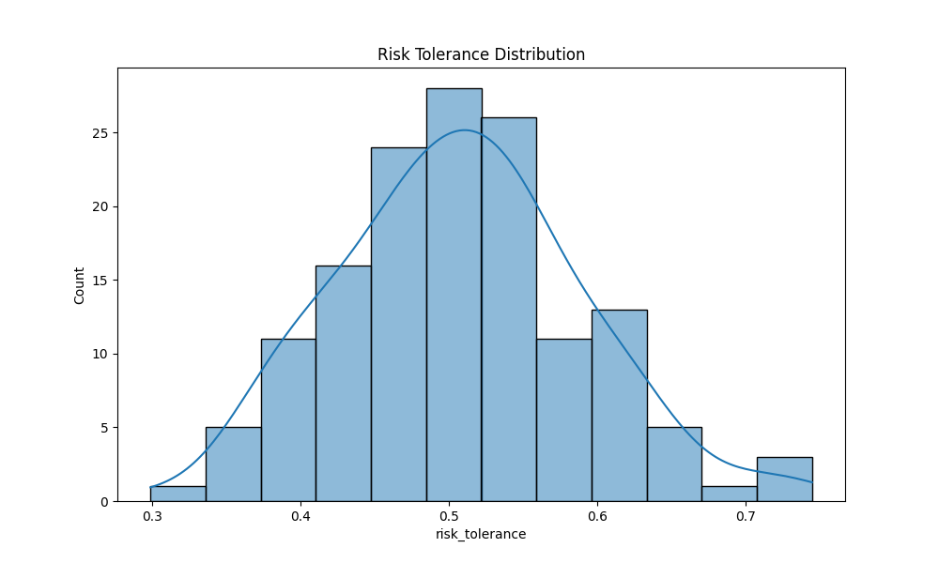
1. Risk Tolerance Distribution
Concentration at Moderate Risk Levels​​: The histogram clearly shows a normal distribution with most individuals (highest counts around 25) clustered in the 0.4-0.6 risk tolerance range. This suggests most people exhibit moderate risk preferences.
​​Minimal Extreme Positions​​: Very few individuals are at the risk tolerance extremes (<0.4 or >0.6), indicating risk aversion or excessive risk-taking are uncommon behaviors.
​​Bell Curve Confirmation​​: The smoothed line validates that risk tolerance forms a near-perfect bell curve when measured at scale.

Slide 4
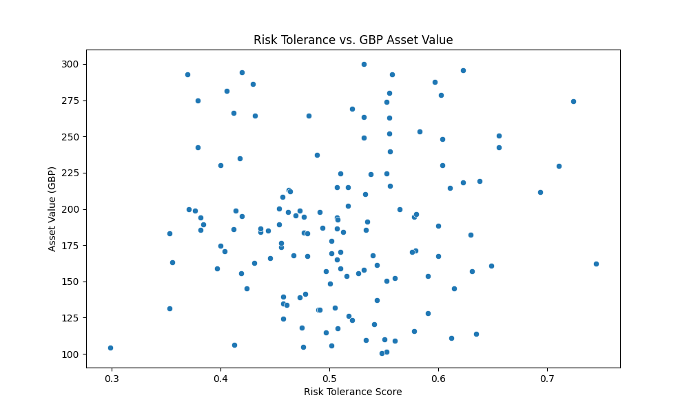
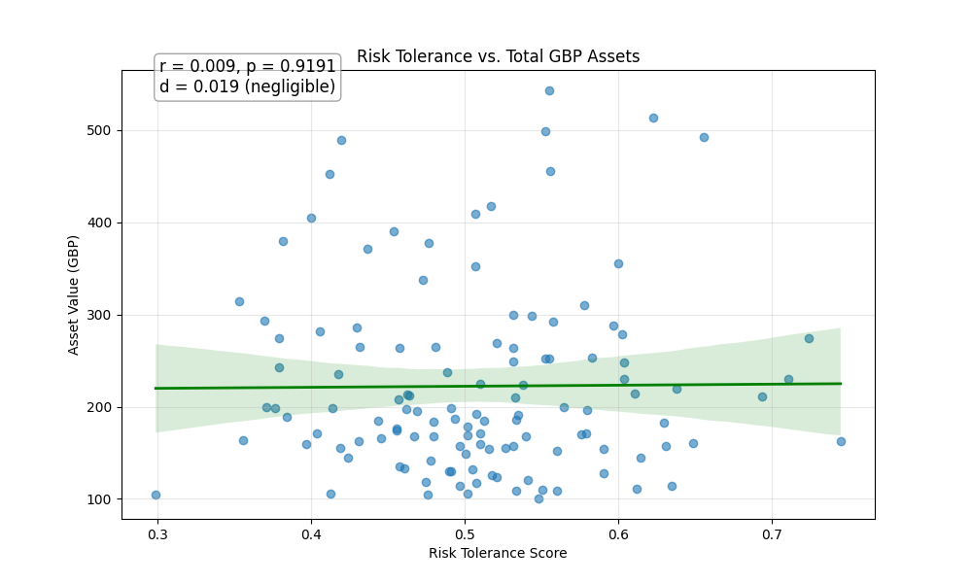
2. Risk Tolerance VS. GBP Asset Value
No Clear Correlation​​: Despite common assumptions, the scatter plot reveals ​​no meaningful relationship​​ between risk tolerance and GBP asset value. High and low risk-takers are equally likely to have low, medium, or high asset values.
​​Outstanding Outliers​​:
Low-risk outliers: At risk tolerance ~0.3, several individuals hold surprisingly high assets (£250-£300)
High-risk outliers: Near 0.7 risk tolerance, we observe multiple people with £250+ assets
Extreme low-value cases: Several investors across all risk levels hold assets ≤£100
​​Value Concentration​​: Most asset values cluster within £150-£250 range regardless of risk score, suggesting a "sweet spot" for typical investments.

Slide 5
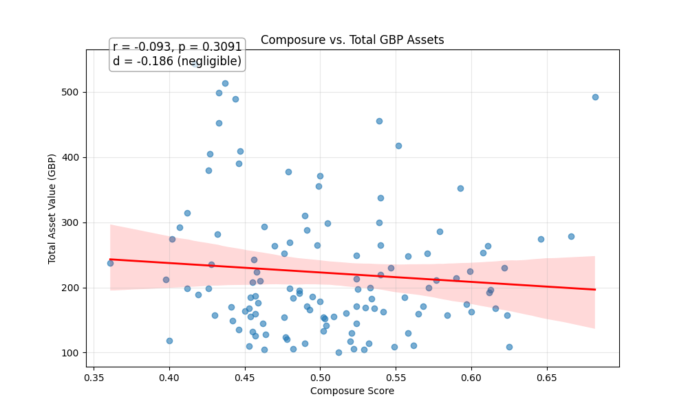
3. Composure VS. Total GBP Assets
Pearson correlation (r): -0.09 (negative) -> contradict with the theoretical hypothesis that "higher composure → higher assets"
The effect size (-0.186) is negligible -> a very weak relationship between Composure and Total GBP Assets
P value: 0.3091 (> 0.05) -> not statistically significant

Slide 6
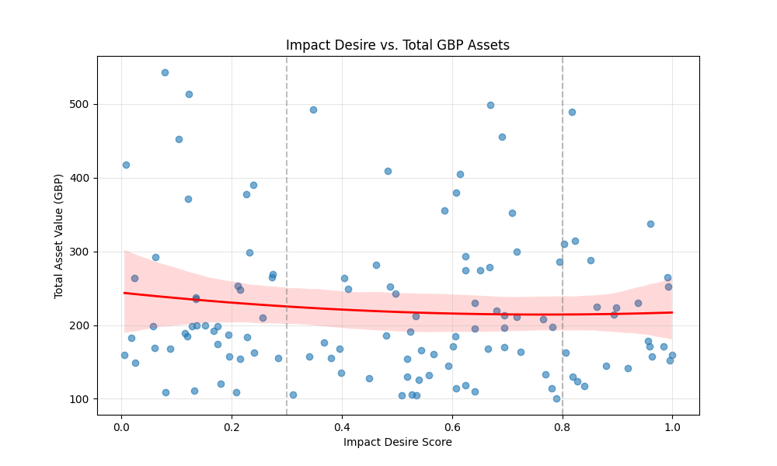
4. Impact Desire VS. Total GBP Assets
Look like a U-shaped curve, however,
Low vs Moderate: p-value = 0.140053
High vs Moderate: p-value = 0.441622
Low vs High: p-value = 0.453254
-> the differences in average assets between these groups are not statistically significant

Slide 7
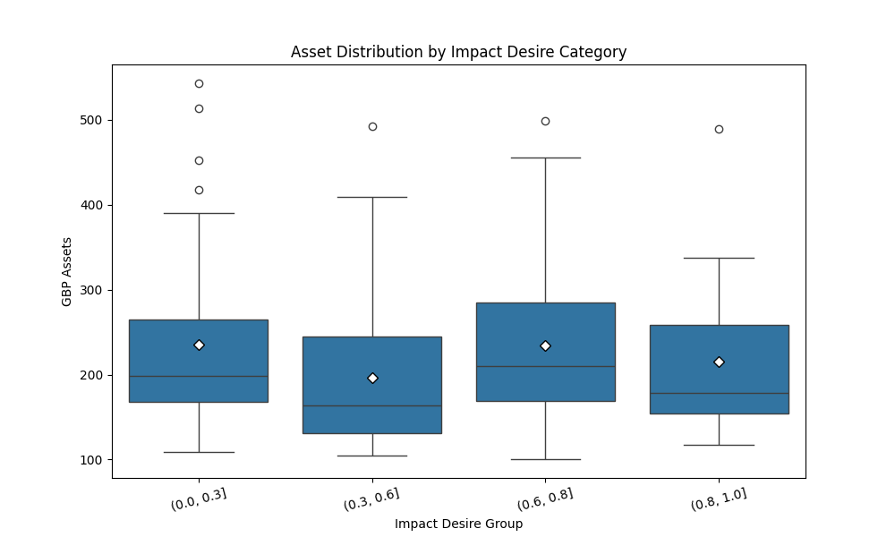
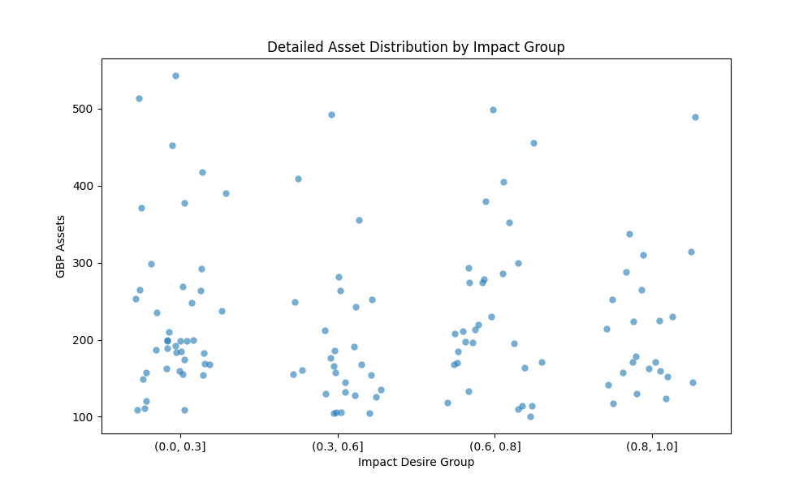
4. Impact Desire VS. Total GBP Assets
the effect size between Low and Moderate (d=0.401) is between small and medium, but the effect size between High and Moderate (d=0.234) is small
The Moderate group has the lowest average, which would be the bottom of a U, but the differences are not significant
Power analysis : 0.313. -> Even though there is a difference, it is hard to detect this

Slide 8
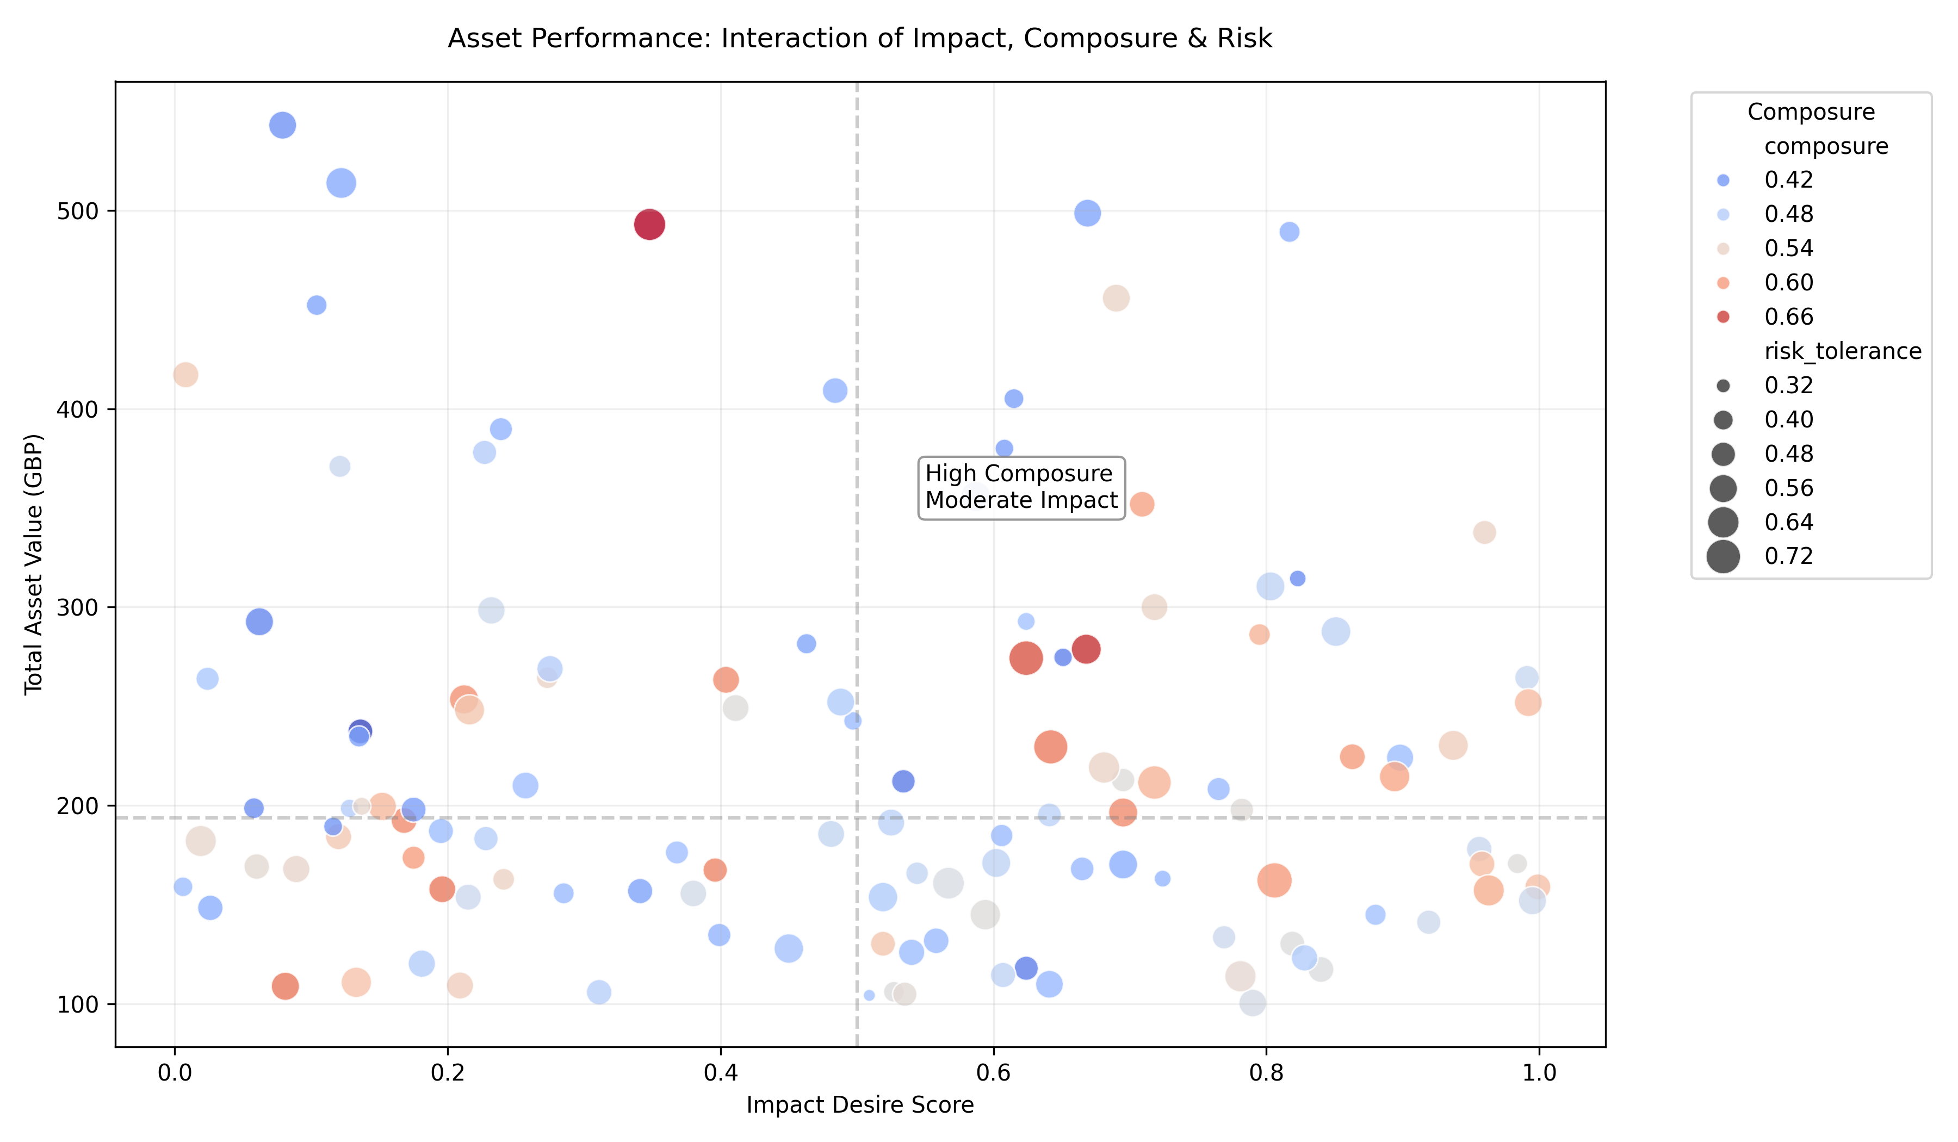
5. Interaction Insights
Optimal performers combine:
Impact desire: 0.4-0.6
Composure: >0.65
Risk tolerance: 0.45-0.55

Slide 9
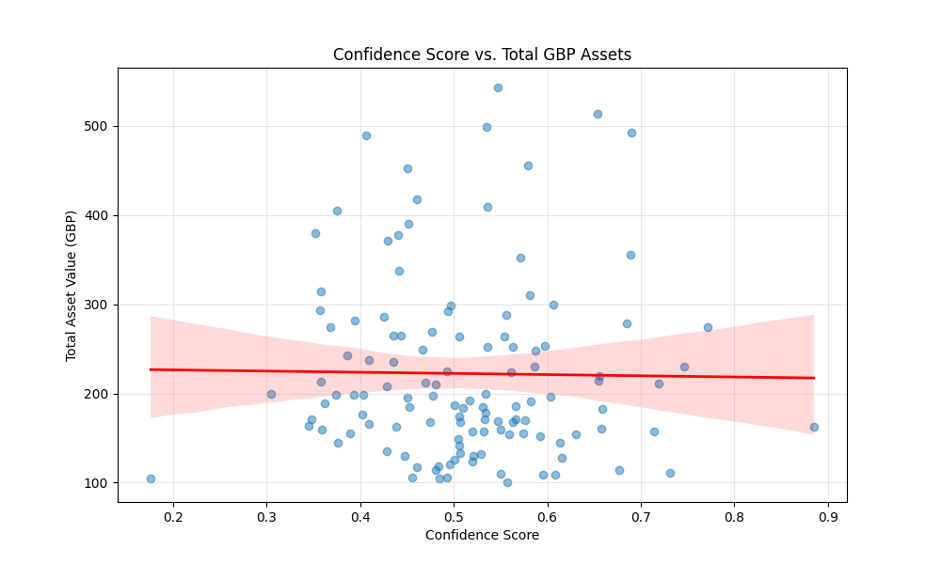
6. Confidence VS. Total GBP Assets
Correlation coefficient: -0.014
p-value: 0.8761
Effect size (Cohen's d): -0.029 (negligible effect)
Statistical significance: Not significant (p > 0.05)

Slide 10
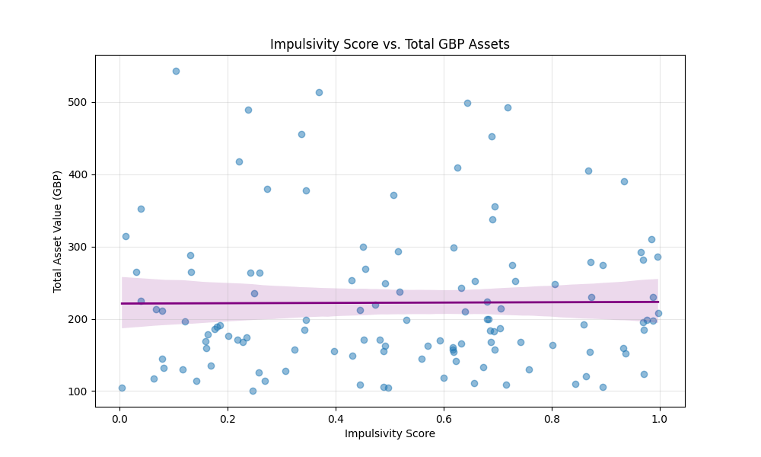
7. Impulsivity VS. Total GBP Assets
Correlation coefficient: 0.007
p-value: 0.9425
Effect size (Cohen's d): 0.013 (negligible effect)
Statistical significance: Not significant (p > 0.05)

